Slide 1
Status Report: Task Set - 2
Suraj Karthic • 19-01-2024

Slide 2
Task List
1. Types of load balancers and its differences.
2. Connect with public ec2 with ALB and NLB.
Linux:
1. How to Find Top Running Processes by Memory and CPU Usage.
2. How to Reset or Change the Root Password in Linux.
3. How to share the files betweeen two systems in same networks and different networks?

Slide 3
The Story of Load Balancer

Slide 4
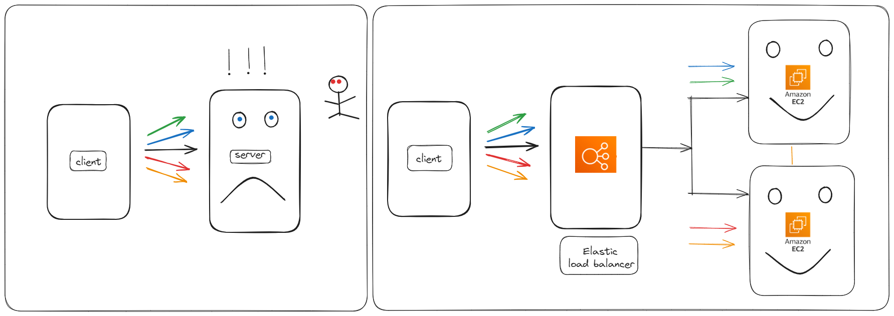
Elastic Load Balancer

Slide 5
Types of Load Balancers in AWS

Slide 6
Classic Load Balancers
Network Load Balancer
1
2
3
4
Application Load Balancer
Gateway Load Balancer

Slide 7
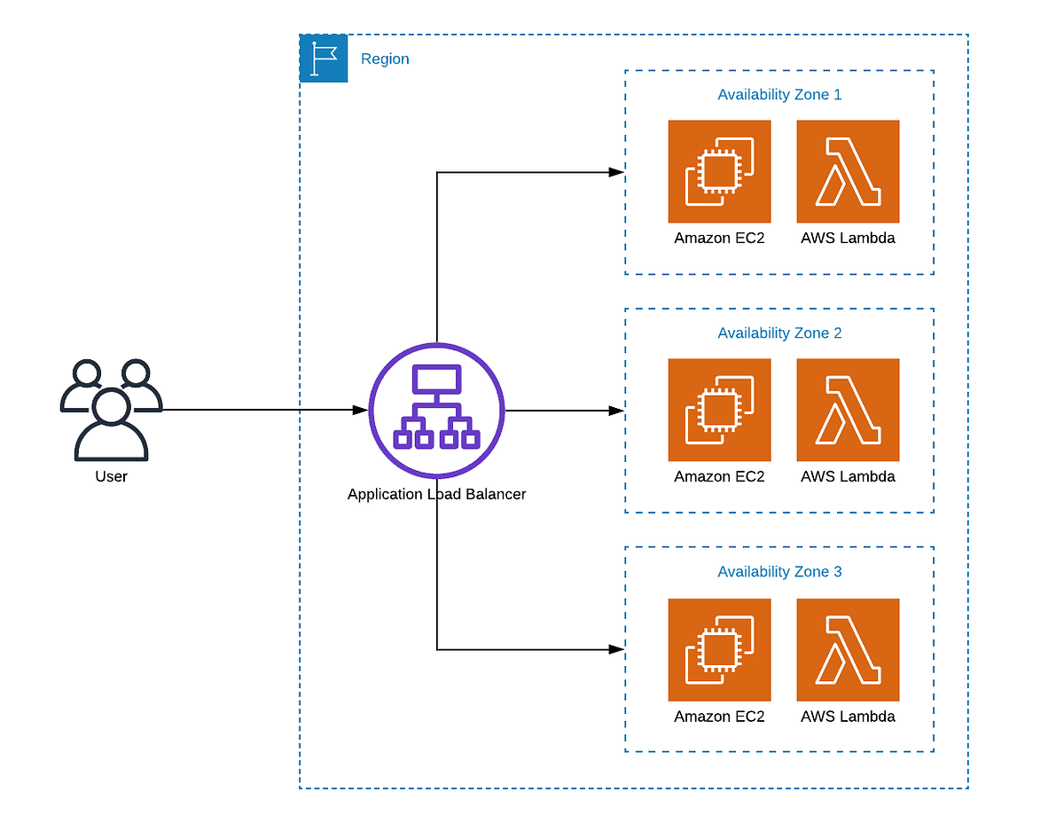
ALB

Slide 8
Key Components of a Application Load Balancer:
Listeners:
ALB uses listeners to check for connection requests from clients. These listeners are configured with specific protocols and ports and are at the forefront of routing decisions.
Rules:
Listener rules define how the load balancer routes requests to its registered targets. Each rule consists of a priority, one or more actions, and conditions. Rules allow for sophisticated traffic management based on various factors.
Target Groups:
These groups route requests to registered targets, such as EC2 instances, using specified protocols and port numbers. A target can be registered with multiple target groups, and health checks can be configured per target group

Slide 9
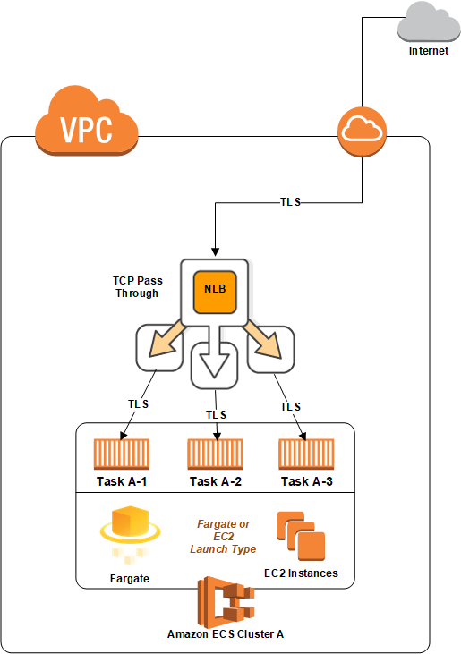
NLB

Slide 10
Key Components of a Network Load Balancer:
Listeners:
NLB uses listeners to check for incoming connection requests from clients. Listeners are configured with specific protocols and ports, serving as the entry point for traffic.
Target Groups:
These groups route incoming requests to registered targets, which can be EC2 instances or IP addresses. You can also configure target groups to support various protocols like TCP, UDP, TCP_UDP, and TLS, providing flexibility.

Slide 11
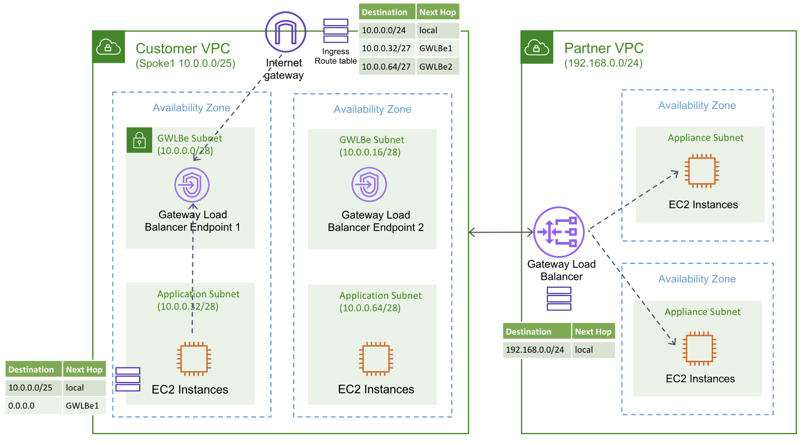
GLB

Slide 12
Gateway Load Balancer Endpoints:
GWLB uses Gateway Load Balancer endpoints to securely exchange traffic across Virtual Private Cloud (VPC) boundaries.
These endpoints facilitate private connectivity between virtual appliances in the service provider VPC and application servers in the service consumer VPC.
Deploying the GWLB in the same VPC as the virtual appliances allows you to register the virtual appliances with a target group for the GWLB.

Slide 13
Target Groups
What it is: A target group is like a collection or group of targets, where each target typically represents an instance of your application (e.g., an EC2 instance).
Purpose: It's used to route incoming traffic to multiple instances based on rules you define.
Example: If you have three instances of your web application, you can create a target group containing these three instances.
Listeners:
What it is: A listener is like a doorway through which traffic enters your environment. It listens for requests on a specific port and protocol.
Purpose: It forwards incoming traffic to the appropriate target group based on rules you configure.
Example: If you want to handle HTTP traffic, you would set up a listener on port 80 for the HTTP protocol.

Slide 14
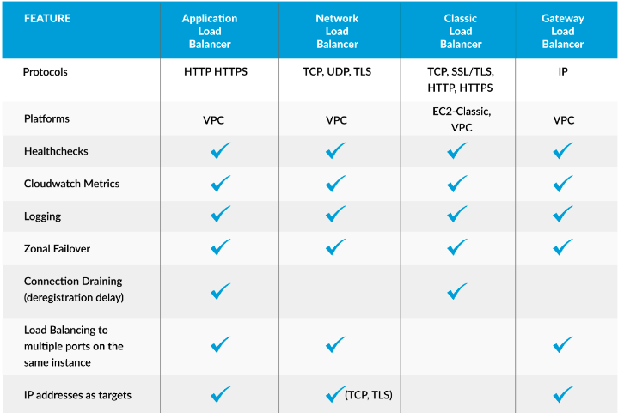

Slide 15
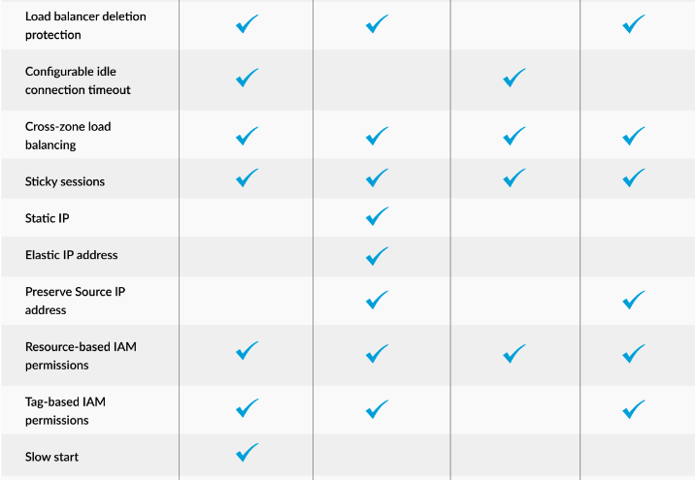

Slide 16
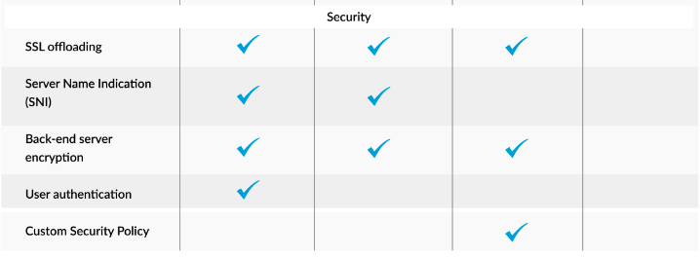

Slide 17
Linux

Slide 18
How to Find Top Running Processes by Memory and CPU Usage?

Slide 19
Commands and Tools
CPU Utilization
Top
Mpstat
Sar
Vmstat

Slide 20
Commands and Tools
Memory and Disk Utilization
Free
Du
df

Slide 21
How to Reset or Change the Root Password in Linux.

Slide 22
Steps:
Step 1: Reboot your Linux system.
Step 2: When the GRUB menu appears (the boot loader menu), select the kernel you want to boot.
Step 3: Once the system has booted into single-user mode, Use the ‘passwd’ command to change the root password.
Step 4: You will be prompted to enter the new password and confirm it.
Step 5: After changing the root password, you can reboot the system.
Step 6 : Once the system has rebooted, log in as the root user with the new password.

Slide 23
How to share the files between two systems in same networks
and in different networks?

Slide 24
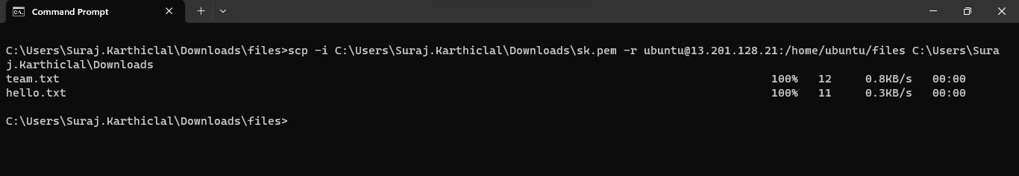
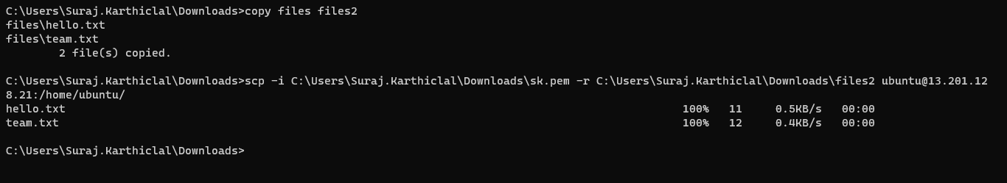

Slide 25
Documentation Link:
https://docs.google.com/document/d/1_M_vqih27XFJ1GoVGRaZaR0uXpOO53pXhtb2P0yvcrA/edit?usp=sharing

